Slide 1
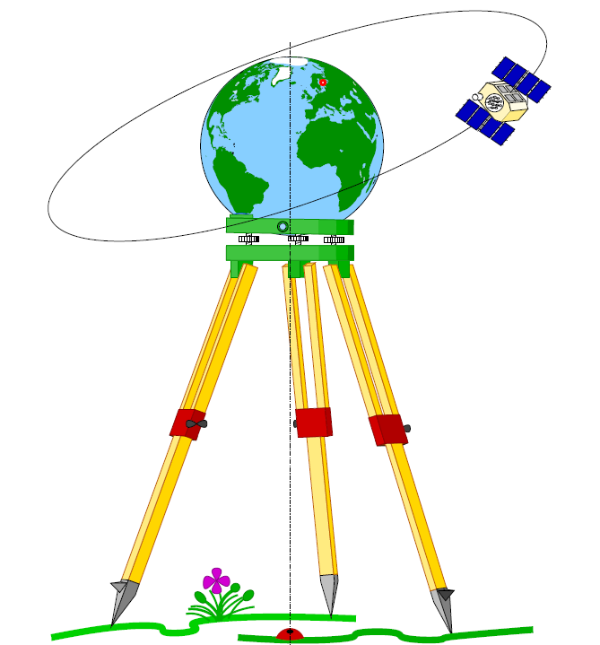
Geodesy

Slide 2
(3) Cartesian geodetic coordinate system (x, y, z)
The cartesian coordinates given by:
x = (N + h) cos ϕ cos λ
y = (N + h) cos ϕ sin λ
z = (N (1 - e²) + h) sin ϕ
Where: N = a/ (1 - e² sin²ϕ)
ϕ, λ, h are geodetic coordinates

Slide 3
a N
tan ϕ = 1 – e²
x² + y² N + h
tan λ = y / x or λ = tan⁻¹ (y/x)
x² + y²
h = - N
cos ϕ
In case of given x, y, z Required: ϕ, λ, h

Slide 4
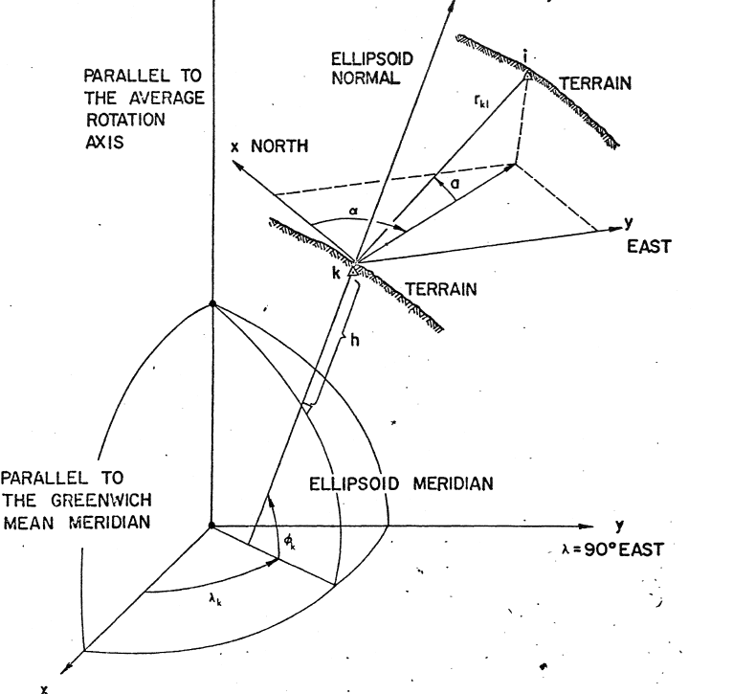
(4) Local geodetic coordinate system (x, y, z)
Z
Origin is the initial point of
observation
X-axis is the north direction
Y-axis is east direction
Z-axis is that complete the
right handed syatem

Slide 5
The local three Cartesian geodetic coordinates are:
XLG = rK1 COS VK1 COS αK1
YLG = rK1 COS VK1 SIN αK1
zLG = rK1 sin VK1
Where r, V, a, α are distance, vertical angle, altitude and geodetic azimuth of line k-1 respectively
V = 90⁰ – a and a = 90⁰ - V

Slide 6
the position vector from observing station k to observed station 1 is given by:
L.G. = Local geodetic
where (a, α, r) are the geodetic altitude, azimuth and range, (ϕ, λ) are the geodetic latitude and longitude.

Slide 7
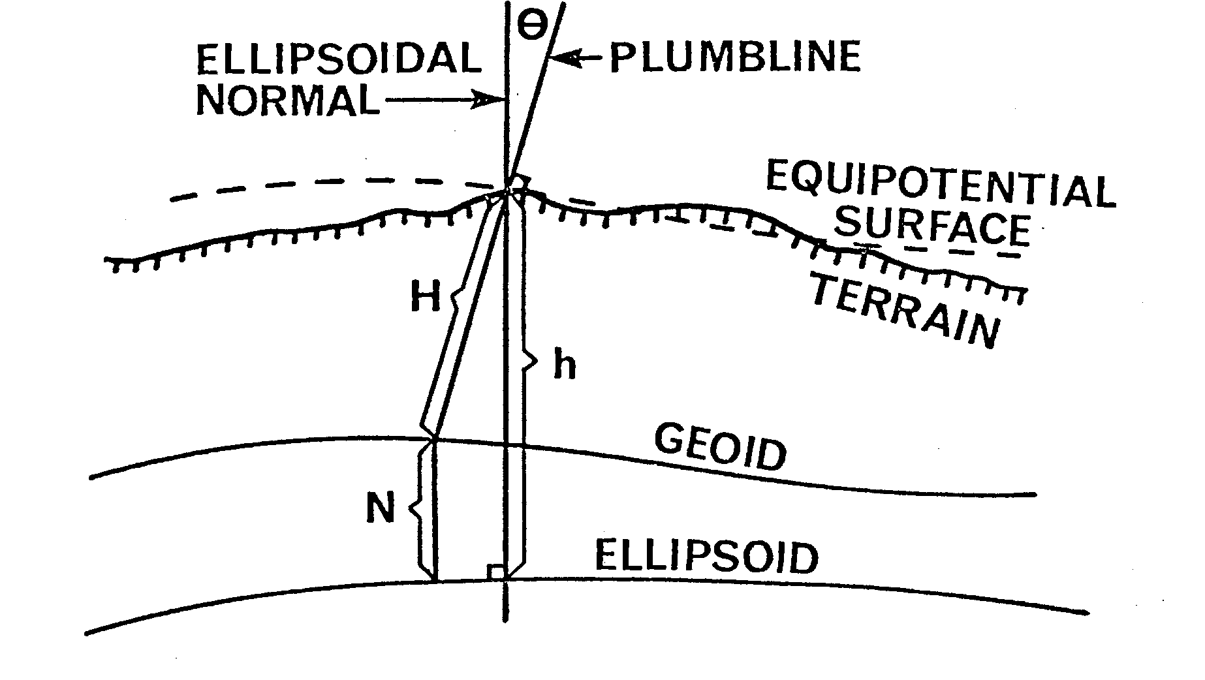
Relation between astronomic and geodetic coordinate systems

Slide 8
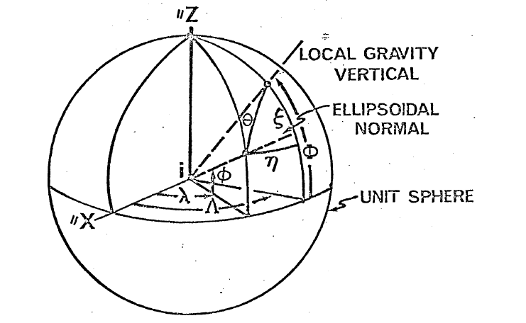

Slide 9
The astro-geodetic (relative) deflection of the vertical (Ɵ) at a point is the angle between the astronomic normal at that point and the normal to the reference ellipsoid at the corresponding point (the point may be on the terrain (Ɵt) or on the geoid (Ɵg ).
Ɵ is normally split into to components, ξ -meridian and
ƞ - prime vertical.
Mathematically, these components are given by:
ξ = ɸ - ϕ
Ƞ = (ᴧ - λ) cos ϕ
The geoidal height (N) given by:
N = h –H
Finally, the relation between the astronomic azimuth (A) and its corresponding one (α) given by:
(A – α) = Ƞ tan ϕ + (ξ sin α – ƞ cos α) cot z

